Slide 1

Group 5
Mobile advertising
Harsh arora, Sanjeev Ahuja and Shubhangi Garg

Slide 2

Workflow
Exploratory Data Analysis
Data Cleansing
Model Building

Slide 3
Exploratory Data analysis:
Performed summaries on the variables in the training dataset and observed the following:

Slide 4
Data cleansing
The field Device_Make had duplicate instances of the same make e.g., (GiONEE, GIONEE), (Acer, acer) etc.
Such instances were grouped for the purpose of analysis.
Further indicator variables were created for selection purpose in the logit model.

Slide 5
Model Building
As per the exploratory analysis performed, in the training dataset 99% of the population is for consumers who didn’t install the ad.
To tackle this problem of Rare Outcomes, we used PROC SURVEYSELECT.
The new dataset had 90% population for consumers who didn’t install the app vs those who installed the app.

Slide 6
Model results
Forward selection technique was used to eliminate the categorical variables created.
The following results were obtained:
Model Fit Statistics
Criterion | Intercept Only | Intercept and
 |  | Covariates
AIC | 4501.148 | 4423.62
SC | 4507.991 | 4498.884
-2 Log L | 4499.148 | 4401.62
Summary of Forward Selection
Step | Effect | DF | Number | Score | Pr > ChiSq
 | Entered |  | In | Chi-Square
1 | publisher_id | 1 | 1 | 42.5732 | <.0001
2 | IPAD | 1 | 2 | 7.093 | 0.0077
3 | DEV_OS_10 | 1 | 3 | 8.5202 | 0.0035
4 | SAMSUNG | 1 | 4 | 7.8857 | 0.005
5 | IPHONE | 1 | 5 | 9.123 | 0.0025
6 | ONEPLUS | 1 | 6 | 11.4776 | 0.0007
7 | ACER | 1 | 7 | 7.7237 | 0.0055
8 | LG | 1 | 8 | 7.8686 | 0.005
9 | HUAWEI | 1 | 9 | 9.1302 | 0.0025
10 | DEV_OS_5 | 1 | 10 | 3.8747 | 0.049

Slide 7
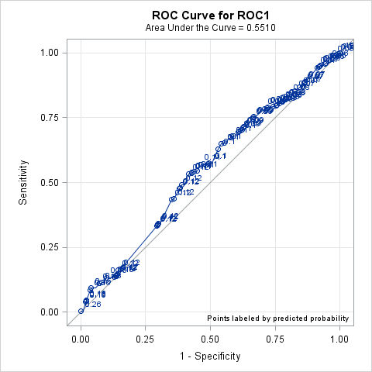
Predictions on test data
We used trained model to predict the installation for the test data.
Sensitivity and Specificity were calculated and ROC was plotted.
ROC curve: the area under the ROC curve was 0.551 with a standard error of 0.016.
ROC Association Statistics
ROC Model | Mann-Whitney |  |  |  | Somers' D | Gamma | Tau-a
 | Area | Standard | 95% Wald
 |  | Error | Confidence Limits
ROC1 | 0.551 | 0.016 | 0.5197 | 0.5824 | 0.1021 | 0.1062 | 0.00176

Slide 8
Classification performance
C1 = Inconvenience Cost (Showing an ad to a consumer who would not install the app)
C2 = Opportunity Cost (Not showing an ad to a consumer who would have installed the app)
Cost ratio = C2/C1
The goal is not to predict the probability of the outcome but to perform a classification to get the least cost

Slide 9
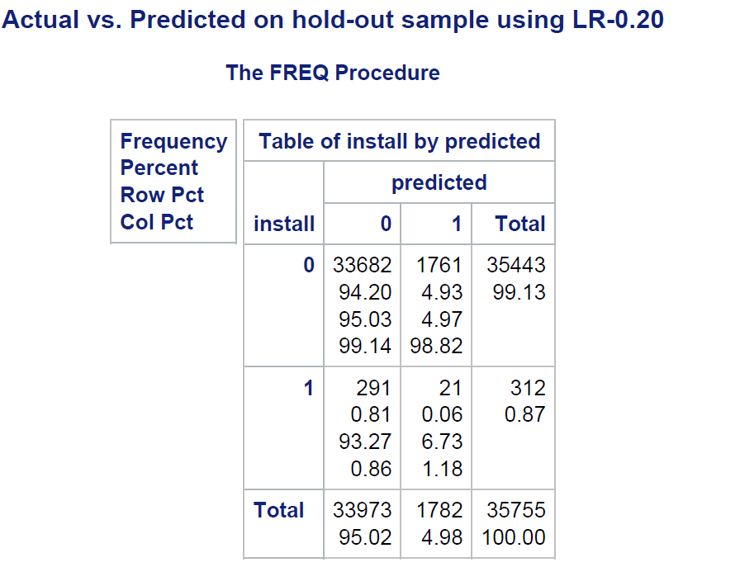
Confusion matrix
We have plotted 8 classification matrix for each of the thresholds we have shortlisted earlier from the ROC curve.

Slide 10
Total costs
P value | FP | FN | Cost FP | Cost FN | Total Cost
0.20 | 1761 | 291 | 7275 | 1761 | 9036
0.17 | 6901 | 234 | 5850 | 6901 | 12751
0.15 | 13056 | 159 | 3975 | 13056 | 17031
0.14 | 21858 | 78 | 1950 | 21858 | 23808
0.13 | 22487 | 74 | 1850 | 22487 | 24337
0.11 | 27551 | 47 | 1175 | 27551 | 28726
0.10 | 33173 | 9 | 225 | 33173 | 33398
For each of the 4 thresholds, we have calculated the total cost with the aim of minimizing it.

Slide 11
Thank You!

